Slide 1
THOBELANG
RE A LE AMOGELA
MIRMA DEVELOPMENT _ 2015
LESOME DIPHALANE

Slide 2
O SWANELA GO BA PHETOGO YE O RATAGO GO E BONA LEFASENG
Re thabela ho tlaleha tse latelang.

Slide 3
2015 - 2016 Production phofu
Ka lebaka la ho moruong wa lefatshe ka ga ekonomi palo ya Marula ha e ile ea eketseha a ho qetela dilemo tse peli le bakeng la 2016 a tla ho dula a le.
Mirma le Distell li sebelitseng ka thata a se ke a fokotseha palo e, re leboha hore.

Slide 4
Mathata a
Se senyenyane palo ha ho etse ho ka kgonega go bogella ditholoana le ditholoana tsohle go tloha mang le mang o mong le o mong sebakeng seo.
Phumantsho ya ditshebeletso otla ketso ena ka go go bogela dibakeng tsa go re thibele go bogela ditholoana

Slide 5
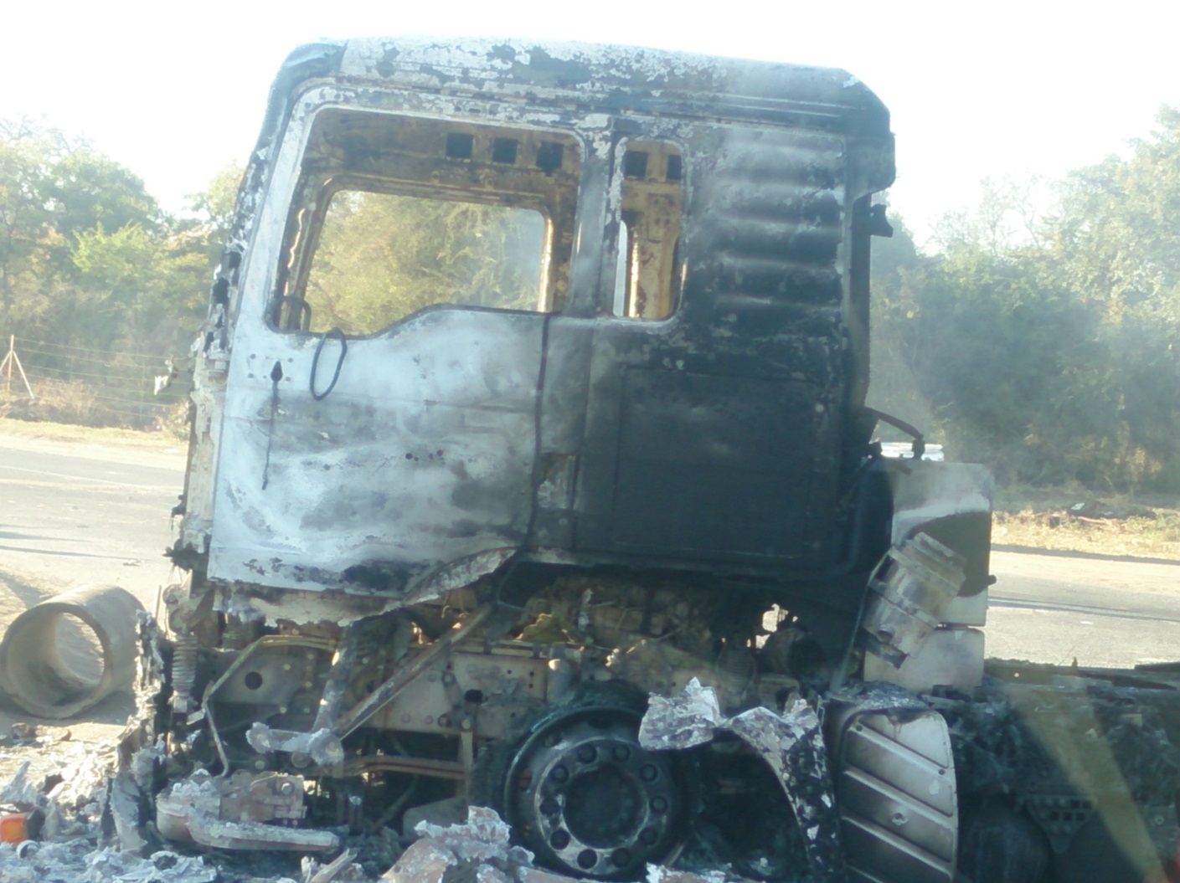
Service boipelaetso mabapi le phumantsho
Ba-Phalaborwa

Slide 6
2015 - PROJECTS

Slide 7
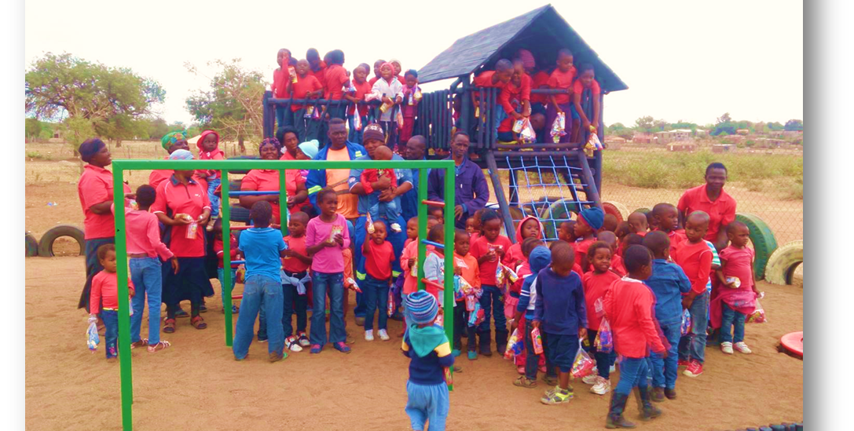
Majeje Day Care – play area
Ge ​ tlelaseng ea boikoetliso, bakeng sa bana go bapala on. 89 bana ba letsatsing lena setsi sa tlhokomelo sa

Slide 8
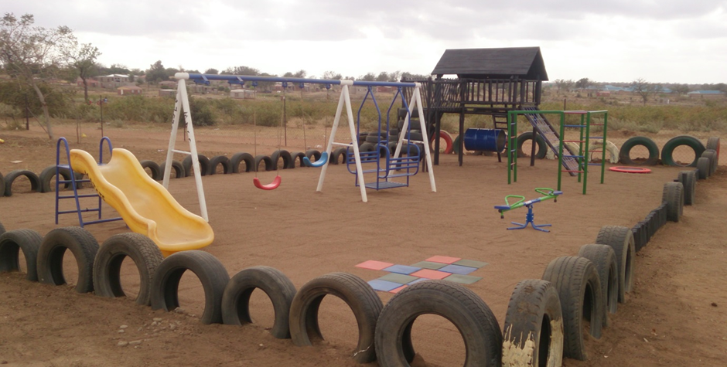
Majeje Day Care
Ge Ba bapala fatše sebakeng seo

Slide 9
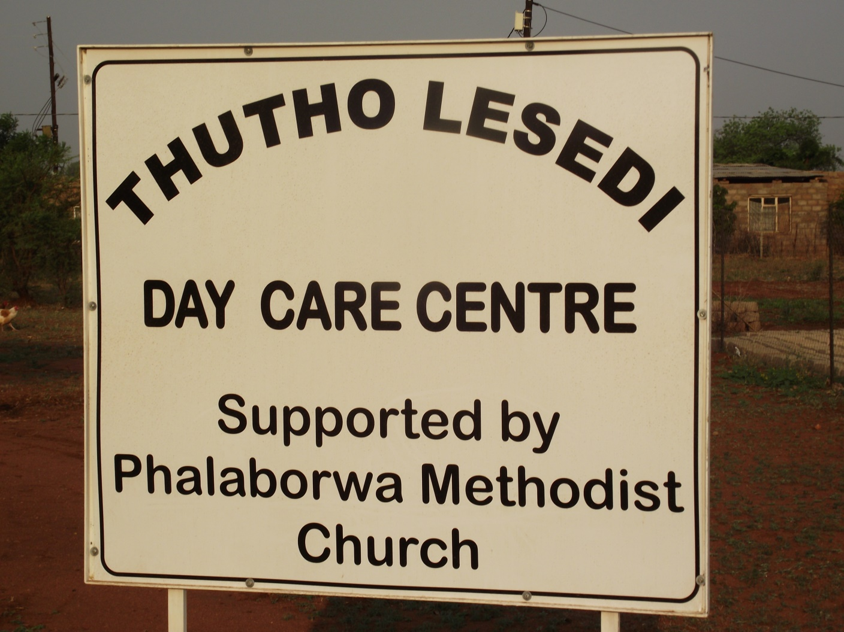
Mashishimale area
Main morero 2015

Slide 10
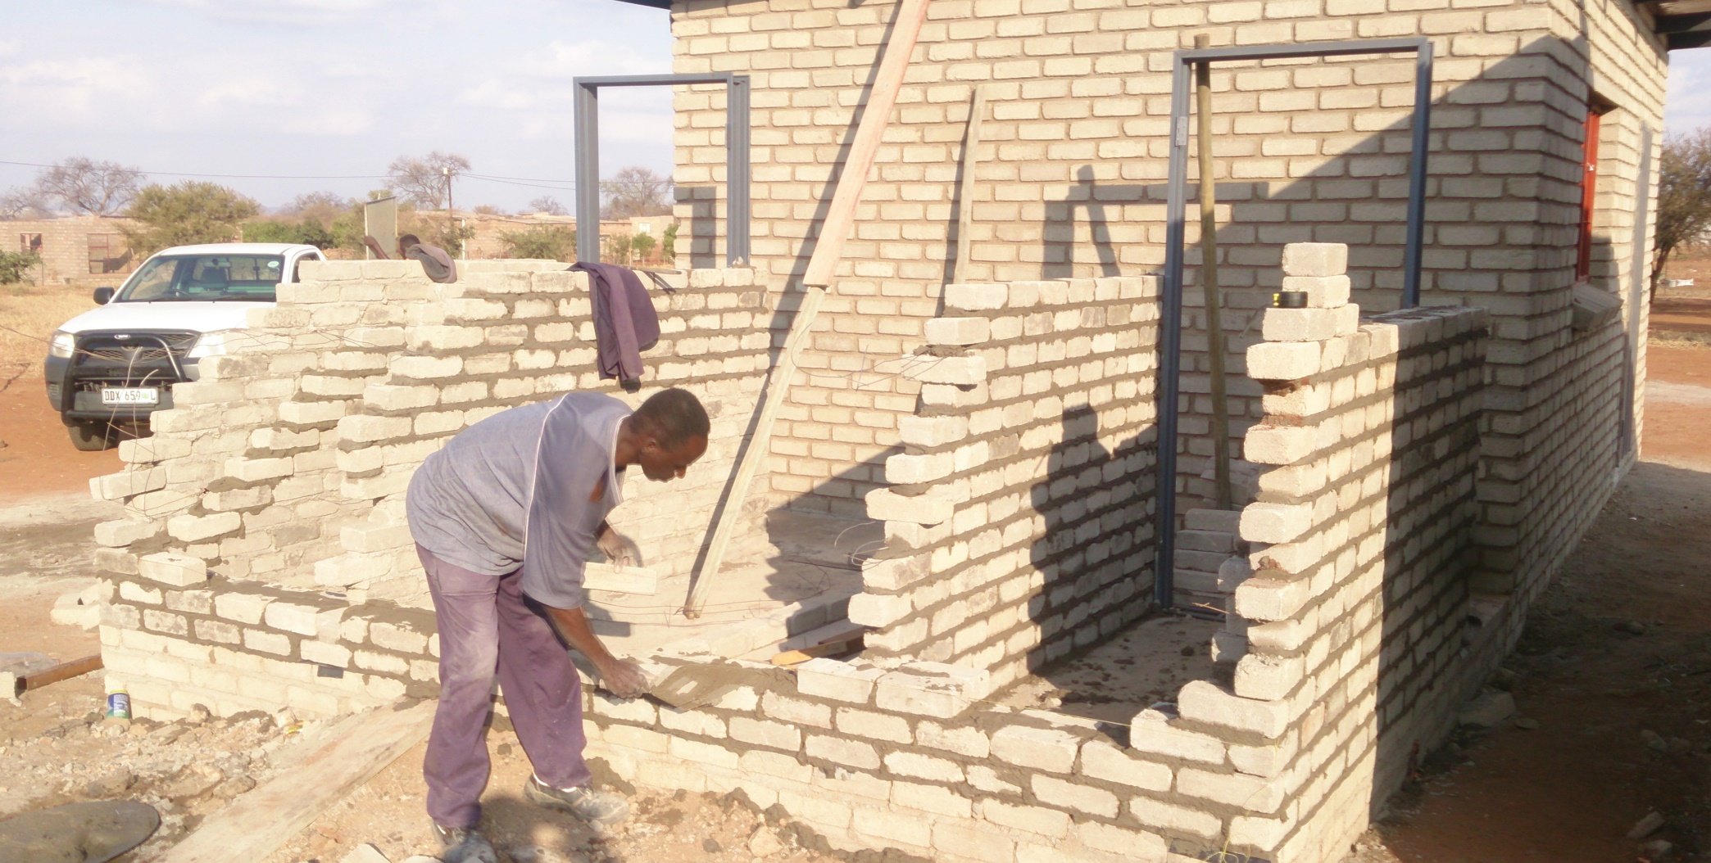
Mashishimale Day care center
Go Thoma morero

Slide 11
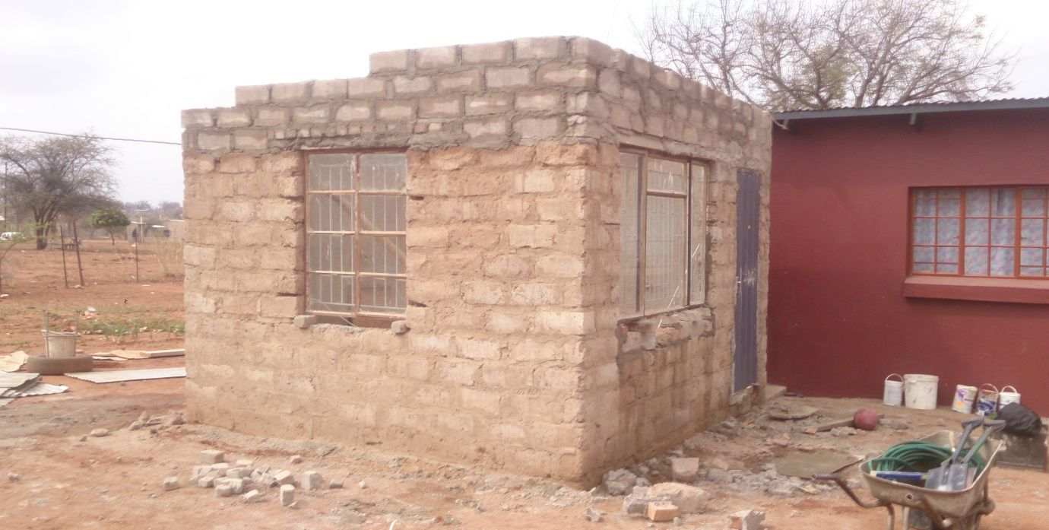
Mashishimale – Day care centre
E Ntlafetseng ka kichineng

Slide 12
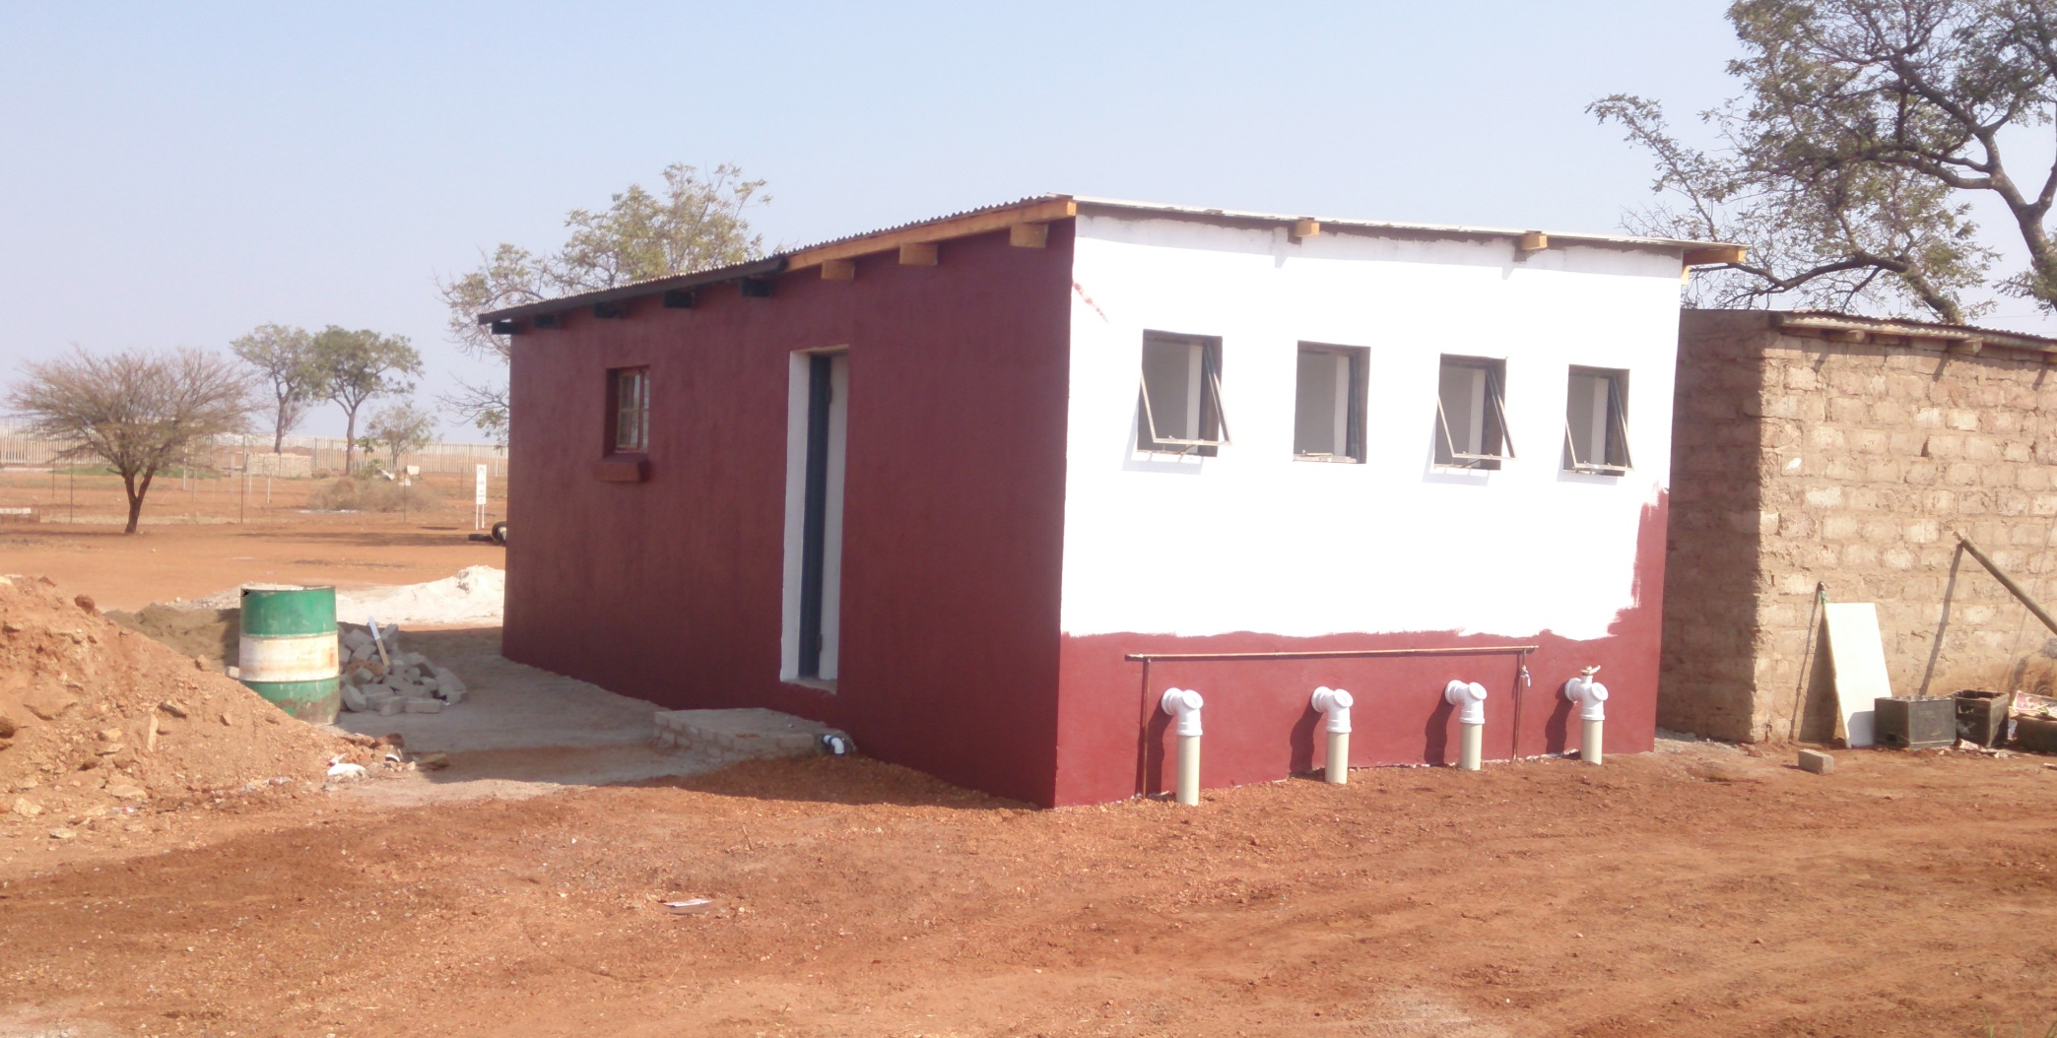
Mashishimale day care center
Di nale matloana a metsi

Slide 13
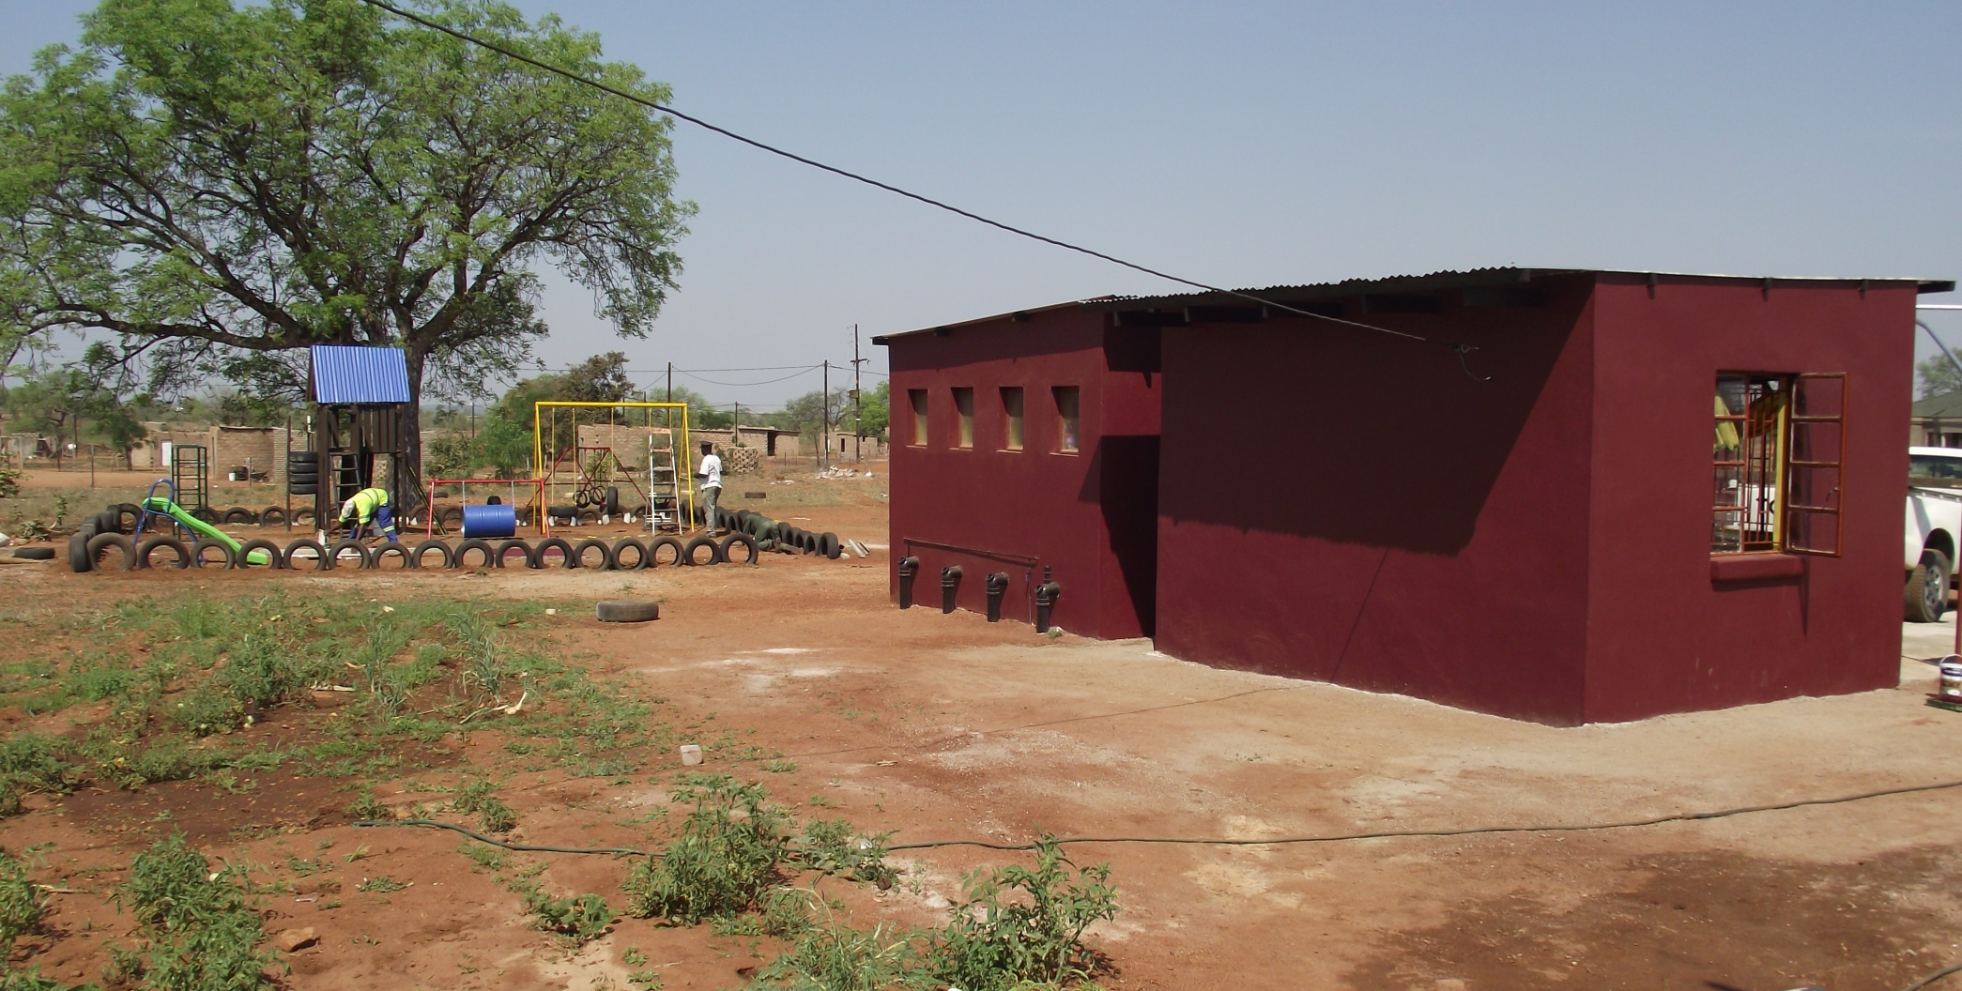
Mashsishimale day care center
New matloana a metsi, kichine sebakeng seo le ho ntlafatsa sehlopha sa kamoreng ea ka

Slide 14
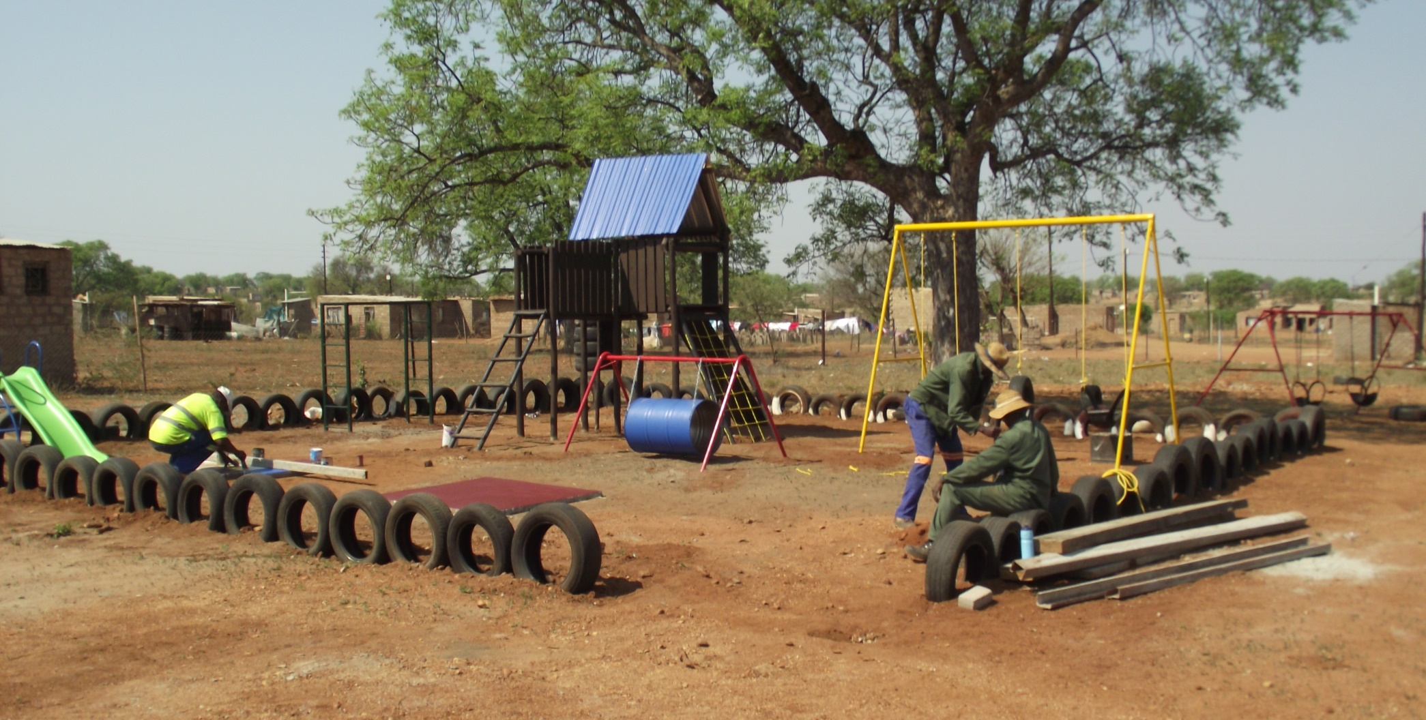
Mashishimale day care centre
New bapala fatše

Slide 15
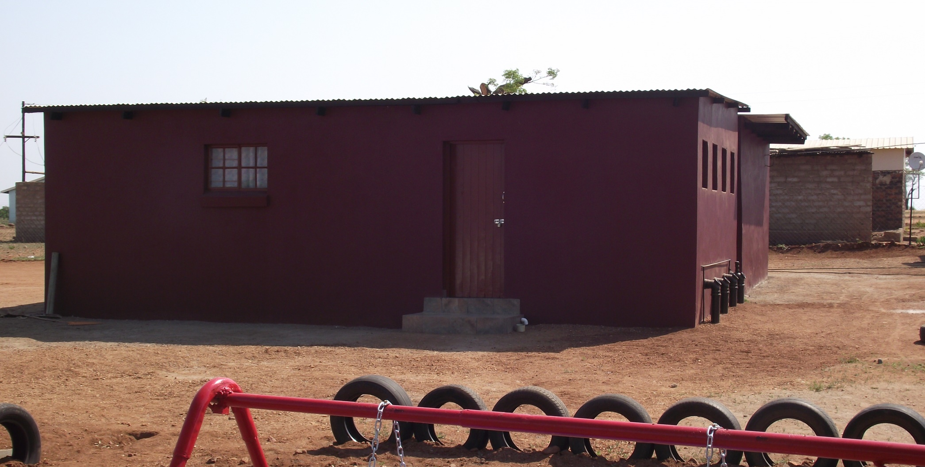
Mashishimale Day care centre
Project ho tlatswa

Slide 16
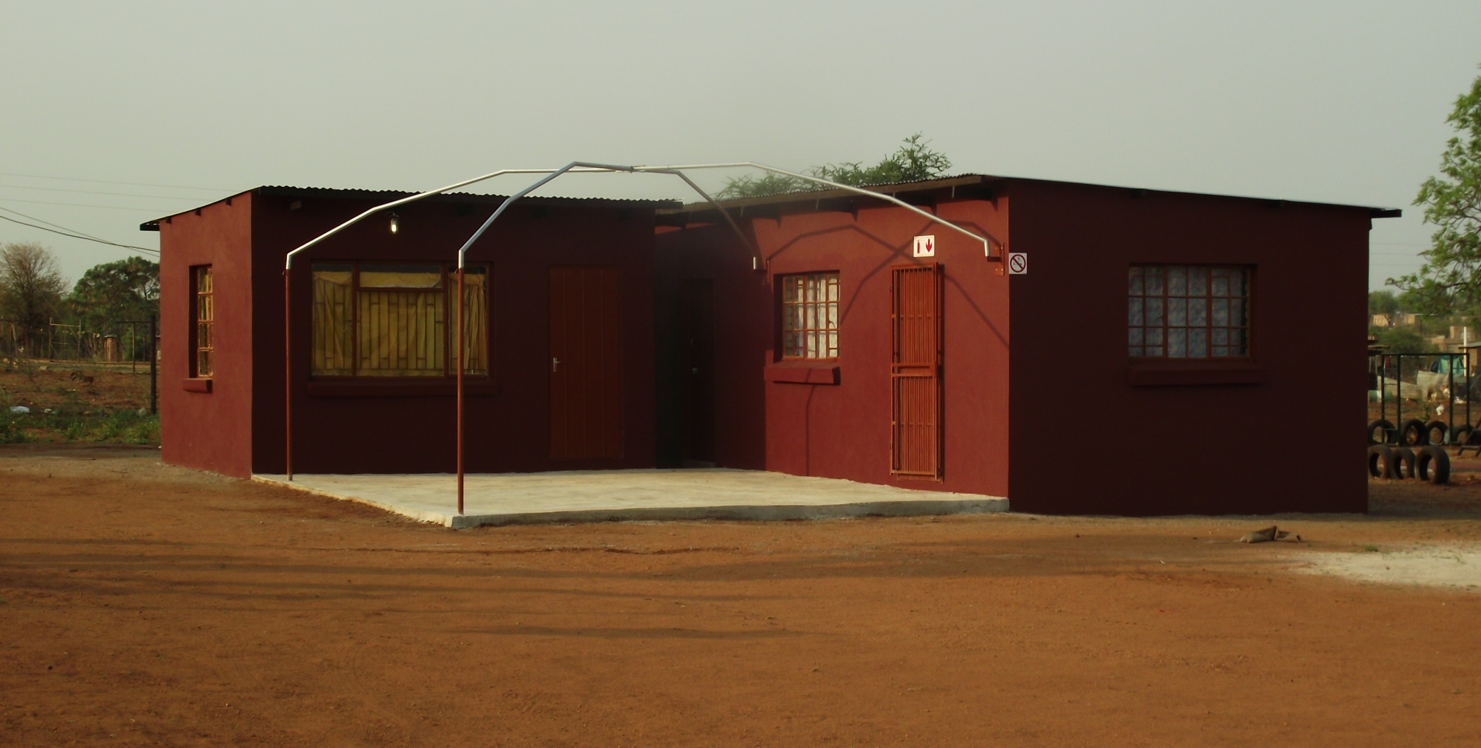
Mashishimale Day care centre -
Front lebaka la phaposing le kichineng

Slide 17
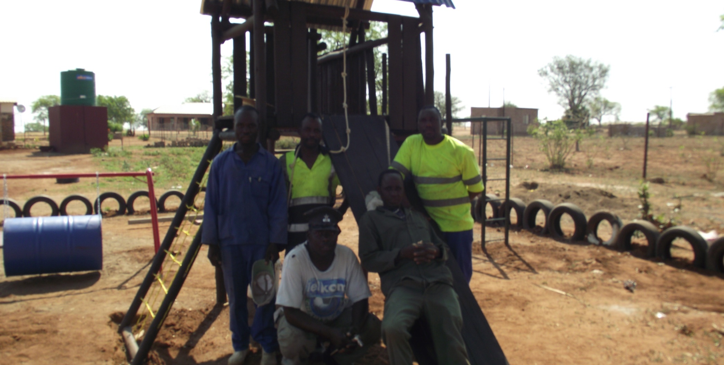
Mashishimale day care centre
Kaho ba le metsi tanka a ema ' go boloka kamoreng ea ka.

Slide 18
2015 – OUT REACH PROGRAMS

Slide 19
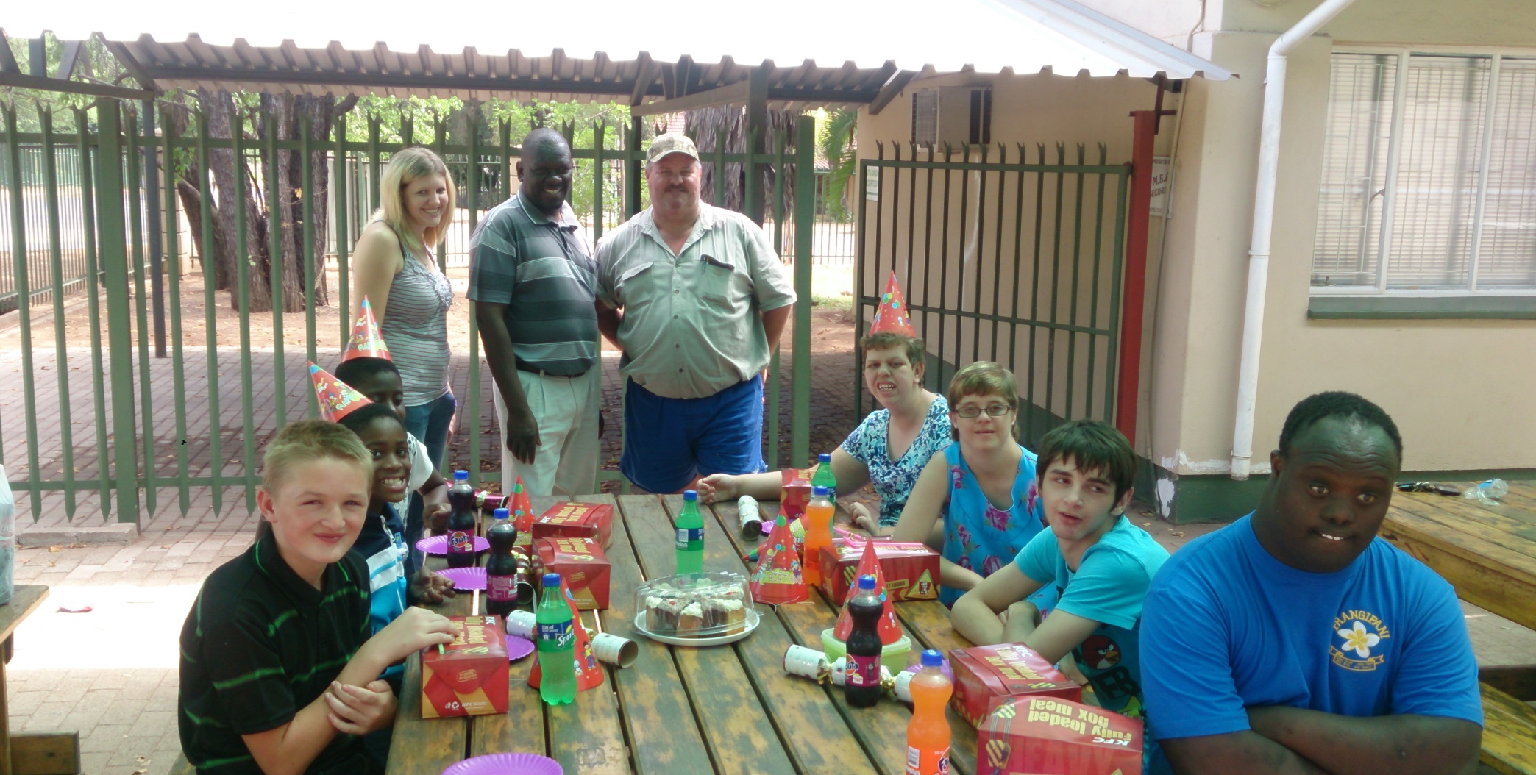
Frangipane care centre
Sekolo sa baba sa ethlakanela go go kelellong batho ba Ba-Phalaborwa

Slide 20
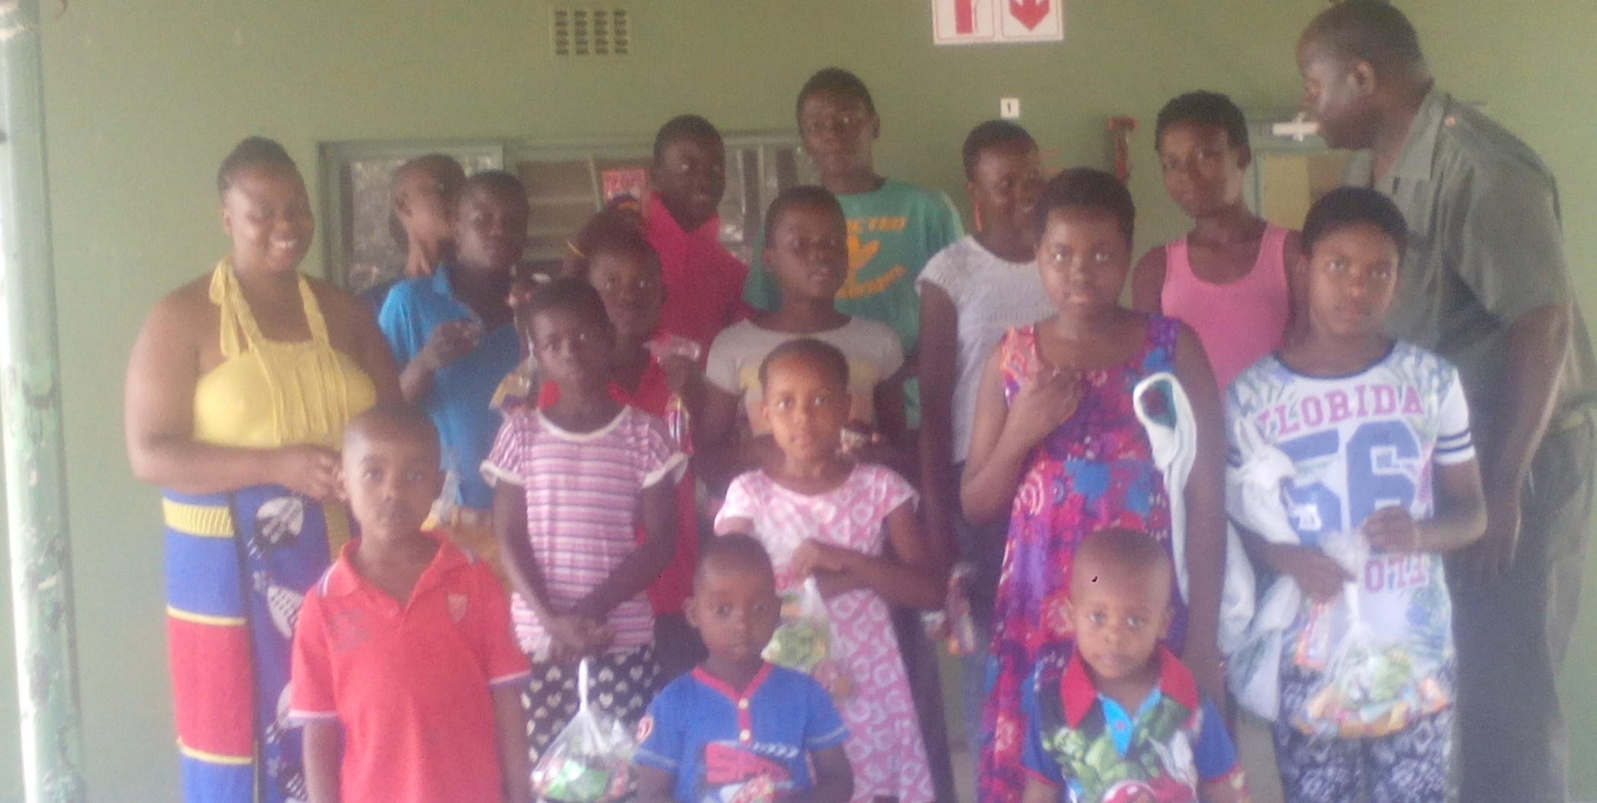
SANParks Ranger station
Le lipompong le limpho go 22 bana ba

Slide 21
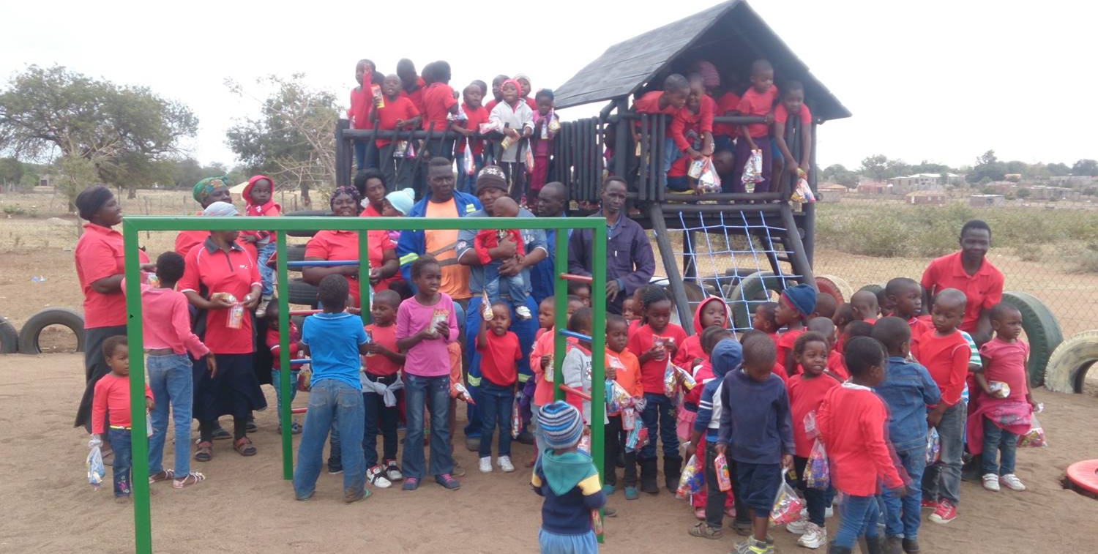
Majeje day care
Go pakela go bana ba go lekana 89 sweet

Slide 22
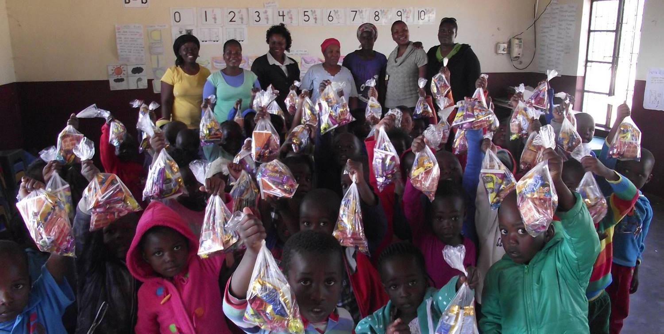
Maseke day care
Go pakela bana ba go lekana 72 ma sweet

Slide 23
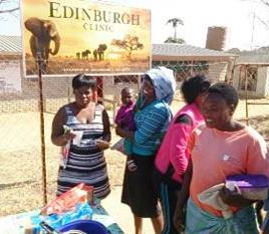
Edinburgh clinic
Sopo e entsoeng ka kichineng

Slide 24
2015 Maintenance Projects

Slide 25
Maintenance Projects
Kheyi Crèche
  Penta sekolong.
  Lokisa go aga
Dumphries Borehole
  Go lokisa pompo e robegilego

Slide 26
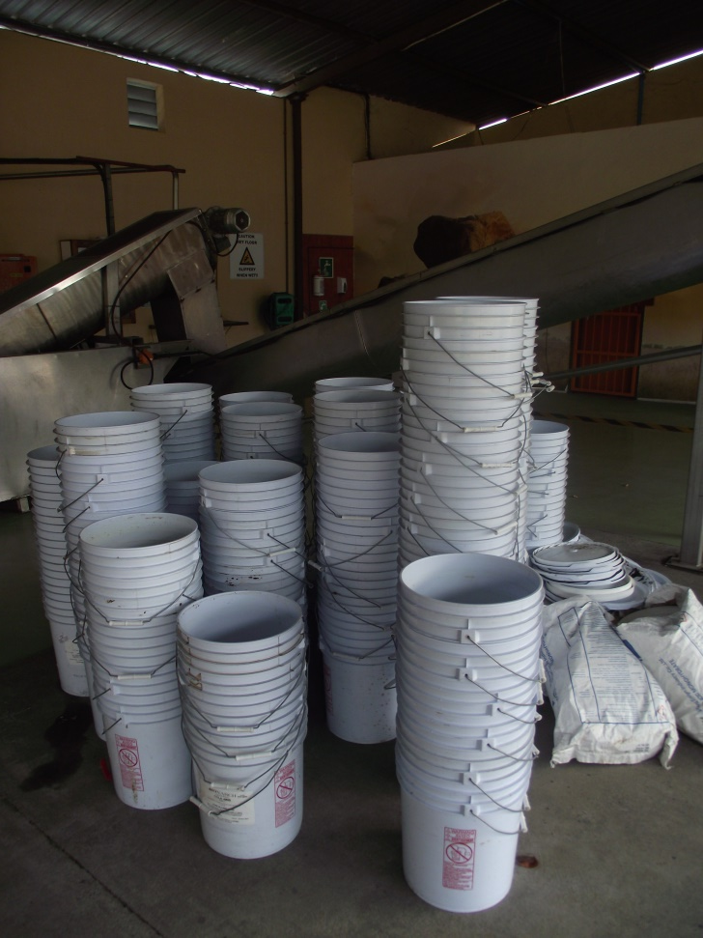
2015 – Ntse go etsa merero ea
Edenburgh clinic – Go negela ka dijo cliniki cooldrink and cake.
Kheyi creche –Ka dimpho tsa Keresemose Letsatsi leo.
.
Hlako village – Re negela ka di bakete tsa metsi.

Slide 27
2015 – Phihlello
Mashishimale – Day care centre.
  New matloana a metsi, kichineng sebakeng seo, bapala fatše 'me metsi tanka le tlas'a moriti sebakeng seo.
Majeje day care center.
  Play fatše sebakeng seo.
Outreach.
  Edinburgh – soup kitchen.
  Gift parcels to Maseke, Frangipane, SANParks rangers, Majeje and Makushane.

Slide 28
2016 - PROJECTS
Main merero ea
MAKUSHANE
LULEKANE
Outreach
  tse tšeletseng dibaka tse fapaneng
Repairs
  Edenburgh clinic
  metsi tanka ema

Slide 29
Re rata go le leboha ka go ba gona legono. Kea le leboha ka go fela legono. Re rapella hore Delimo o tla hlohonolofatsa kaofela le hore re ka sebetsa bohle hammoho hape ena go fihlela ka nako ya Marula.
Mirma Development.

