Slide 1
2017
MIRMA DEVELOPMENT

Slide 2
FOOD RELIEF PROJECT
10218 PEOPLE RECEIVED FOOD PARCELS (SWEET POTATOES).
  138 Crèches
  42 Drop In Centres
  16 Initiations for vulnerable people
  Each individual received 12kg sweet potatoes enough to sustain them for 12 days.

Slide 3
FOOD RELIEF PROJECT
10218 BATHO BA FUMANENG LIJO PARCELS (SWEET POTATOES).
138 Litente
42 Ho theohela liphuthehong
16 Litsamaiso bakeng sa batho ba tlokotsing
Motho e mong le e mong o fumane litapole tse 12kg ho lekaneng ho li boloka matsatsi a 12.

Slide 4
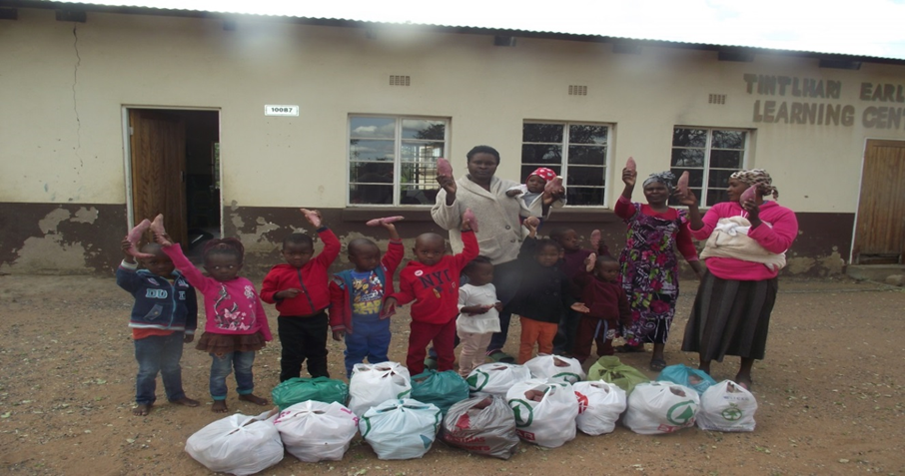
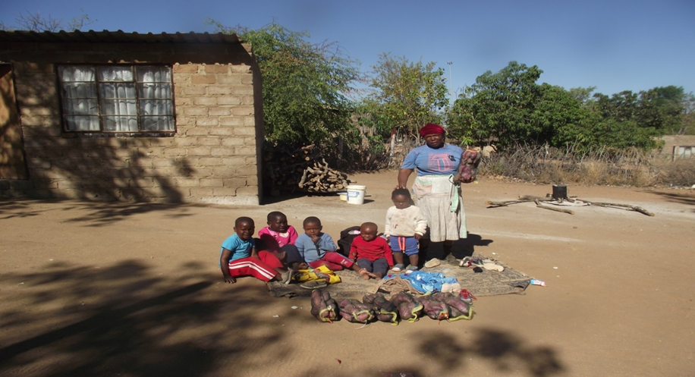
Food relief project

Slide 5
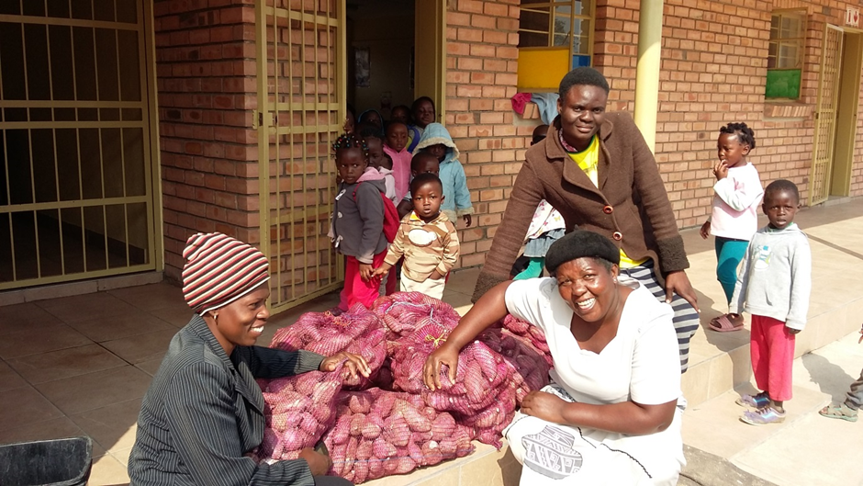
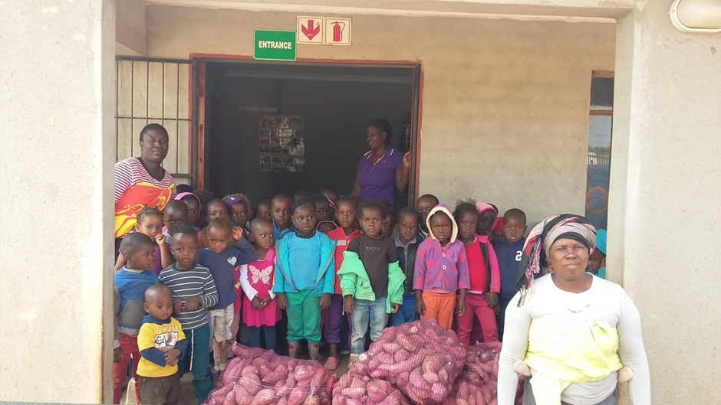
Food relief project

Slide 6
Base water crèche improvement
  As part of the rotational plan to ensure that we do a major project in each region we completed the cycle by identifying a crèche in Base water that needed urgent repairs. The identification was done by community leadership and the project started in April 2017.
  Project details
    Replace all broken windows
    Repaint all class rooms
    Replace broken ceilings
    Supply curtains
    Build bidden to ensure no further water damage to structures
    Supply new jungle gym play area
    Supply a 6m x 3m vegetable nursery hot house for vegetable production.
  Beneficiaries of the project 97 pre-school children between the ages of 3months and 5 years and 8 care givers.

Slide 7
Base water crèche improvement
E le karolo ea moralo oa ho potoloha ho etsa bonnete ba hore re etsa morero o moholo sebakeng se seng le se seng seo re se qetileng potoloho ka ho khetholla sekhahla sa metsi a Metsi se hlokang ho lokisoa kapele. Boitsebiso bo entsoe ke boetapele ba sechaba le morero o qalile ka April 2017. Lintlha tsa morero Kenya sebaka sa lifensetere tsohle tse robehileng Khutlisa likamore tsohle tsa tlelase Tlosa lisebelisoa tse robehileng Lisebelisoa tsa ho fana Ho hahoa hore ho be le tšenyo e eketsehileng ea metsi mehahong Fana ka sebaka sa ho ikoetlisa se seng sa meru Fana ka ntlo ea matlo ea limela tsa meroho tse 6m x 3m bakeng sa tlhahiso ea meroho. Melemo ea morero oa bana ba 97 ba pele ho sekolo pakeng tsa lilemo tse 3months le lilemo tse 5 le ba 8 ba tsotellang.

Slide 8
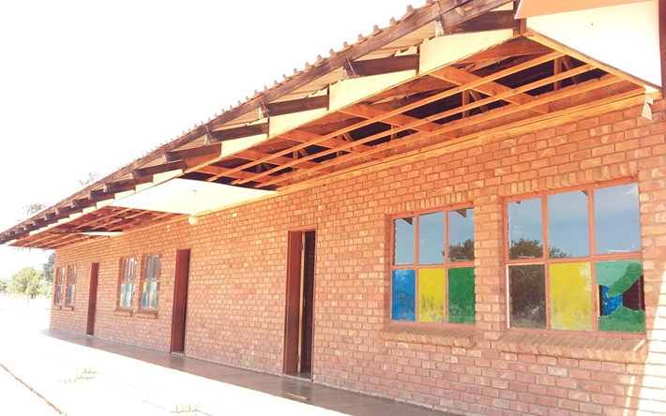
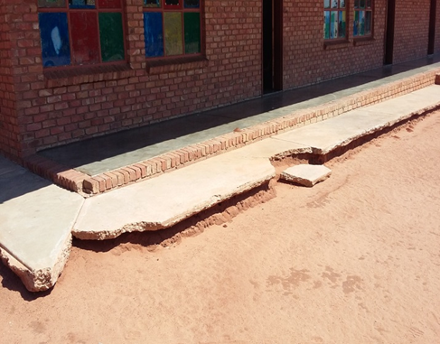
Base water crèche improvement
BEFORE
BEFORE

Slide 9
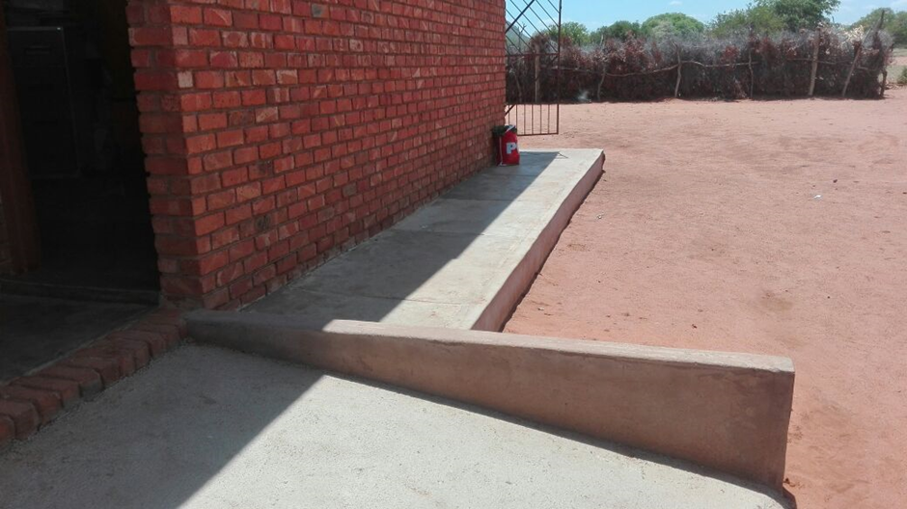
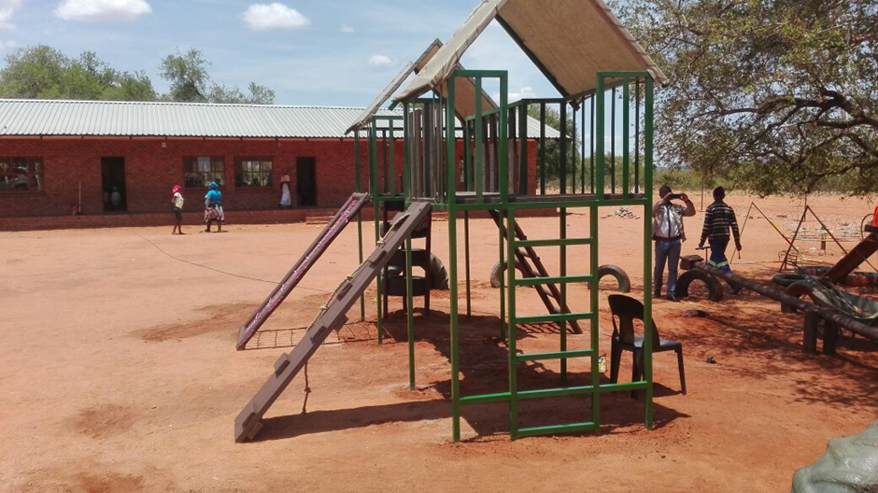
Base water crèche improvement
AFTER
AFTER

Slide 10
KRUGER NATIONAL PARK – SOCCER KIT DONATION
  The elephant is the icon brand of Amarula cream and the Kruger National park is one of the three largest protected areas in Africa and world renowned brand like Amarula. As we all know Elephant all over the continent are under serious threat from increased poaching. The Kruger National Park is one of the last and largest safe havens for these animals but they also have to deal with the increasing amount of elephant poaching incidents.
  In the last three years there has been a steady increase in the incidents in the Kruger National Park. As being our neighbours in Phalaborwa we decided to assist in an imitative called “project relax” where by private institution could assist field rangers sections in various ways to relax and take their minds off the daunting task of confronting these armed elephant poachers.
  As Mirma development we decided to sponsor three different rangers section with complete soccer kits. All these ranger sections are in the northern and far northern region of the reserve where the Elephant poaching is active. This is the areas where the poachers target the Elephants as no Rhinos are found in the Northern regions.

Slide 11
KRUGER NATIONAL PARK – SOCCER KIT DONATION
Nlou ke letšoao la Amarula cream le Paraka ea Sechaba ea Kruger ke e 'ngoe ea libaka tse tharo tse sirelelitsoeng ka ho fetisisa Afrika le lebitso la hae le tummeng la Amarula. Ha re ntse re tseba hore Tlou e pholletsa le k'honthinente e kotsing e tebileng ho tloha poeteng e eketsehileng. Kruger National Park ke e 'ngoe ea libaka tse ho qetela tse sireletsehileng tse sireletsehileng bakeng sa liphoofolo tsena empa hape li tlameha ho sebetsana le liketsahalo tse eketsehileng tsa tlou ea tlou. Lilemong tse tharo tse fetileng ho bile le keketseho e tsitsitseng liketsahalong tsa Kruger National Park. Kaha re ba baahelani ba rona Phalaborwa re ile ra etsa qeto ea ho thusa ho etsisa "morero oa boikhathollo" moo setsi sa puso ea sechaba se ka thusang likarolo tsa likotsi tsa tšimo ka litsela tse fapaneng tsa ho phomola le ho hopola mosebetsi o boima oa ho loana le masole a litlou a hlometseng. Ha re ntse re ntlafatsa Mirma re ile ra etsa qeto ea ho tšehetsa karolo e meraro ea likotsi tse fapaneng le lihlopha tse feletseng tsa bolo ea maoto. Likarolo tsena tsohle tsa libaka li sebakeng se karolong e ka leboea le e ka leboea ea sebaka seo polokelo ea litlhapi e sebetsang ho sona. Tsena ke libaka tseo masholu a lebisitseng litlou ka tsona ha ho na li-Rhine tse fumanoang libakeng tse ka leboea.

Slide 12
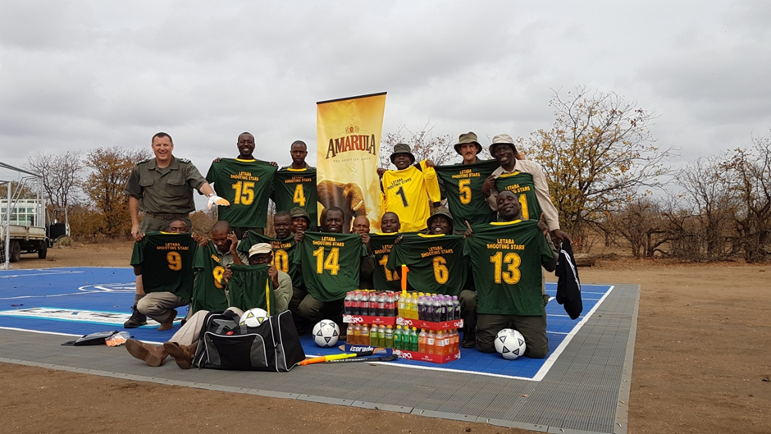
KRUGER NATIONAL PARK – SOCCER KIT DONATION

Slide 13
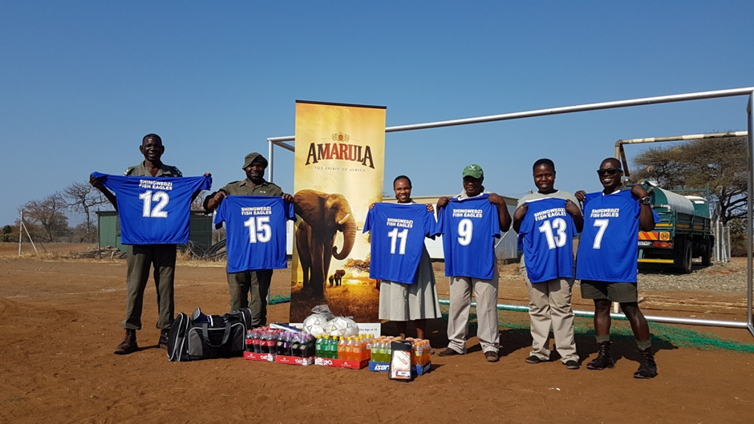
KRUGER NATIONAL PARK – SOCCER KIT DONATION

Slide 14
Guwela crèche improvement – Dzumeri area
  Mirma Development has start the 2nd round on the rotation plan for a major project. We are doing a project in the area of Chief Mabunza and they have identified the Guwela village as the beneficiary area.
  Project details
    To construct a new flush toilet block with a girls and boys section
    Repair and maintenance work to present school buildings
    Erect a water tank stand for better water pressure
    Refurbish the jungle gym
    Plant 24 Marula trees in the crèche area.
  Beneficiaries are 81 children and 8 care givers.

Slide 15
Guwela crèche improvement – Dzumeri area
Thuto ea Mirma e qalile ho potoloha habeli holima morero o moholo. Re etsa morero sebakeng sa Chief Mabunza mme ba fumane motse oa Guwela e le sebaka sa ba ruileng. Lintlha tsa morero Ho haha ​​setulo se secha sa ntloana le banana le bashanyana karolo Mosebetsi oa ho lokisa le ho lokisa ho fana ka mehaho ea sekolo Emisa tanka ea metsi ho ema bakeng sa khatello e ntle ea metsi Lokisa ho ikoetlisa ka merung Jala lifate tse 24 tsa Marula sebakeng sa koluoa. Ba ruileng molemo ke bana ba 81 le bahlokomeli ba 8.

Slide 16
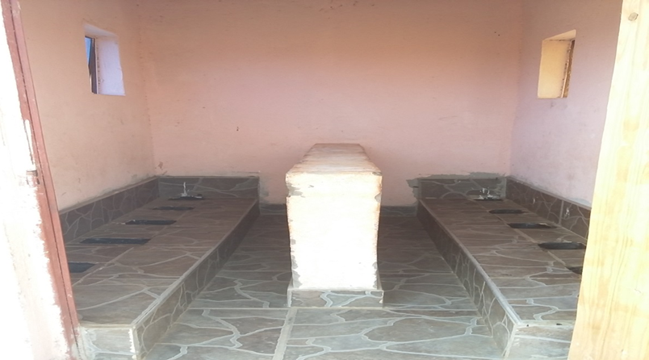
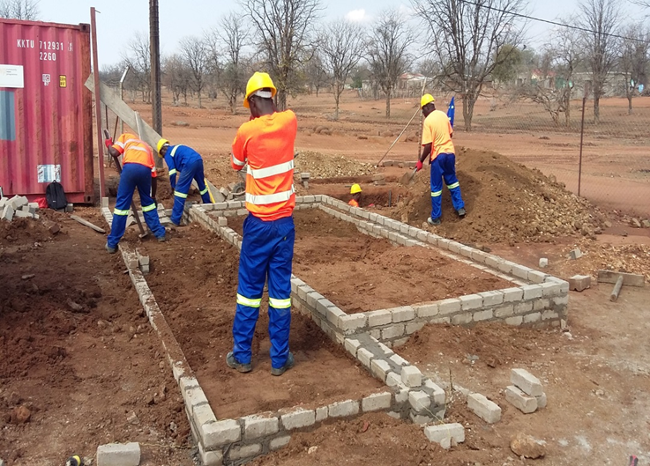
Guwela crèche improvement – Dzumeri area
BEFORE
BEFORE

Slide 17
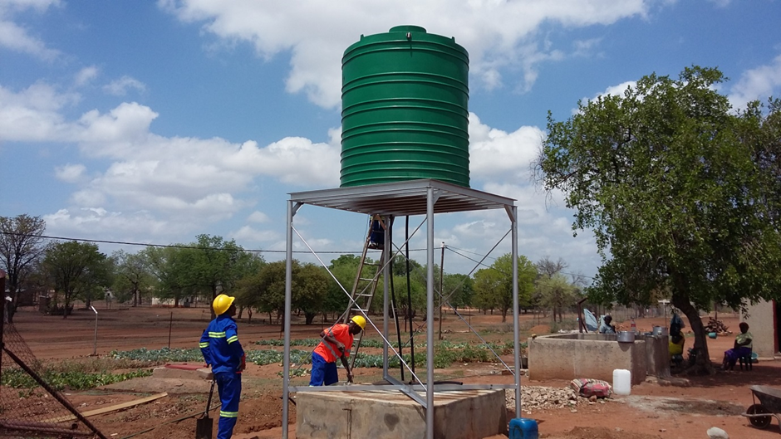
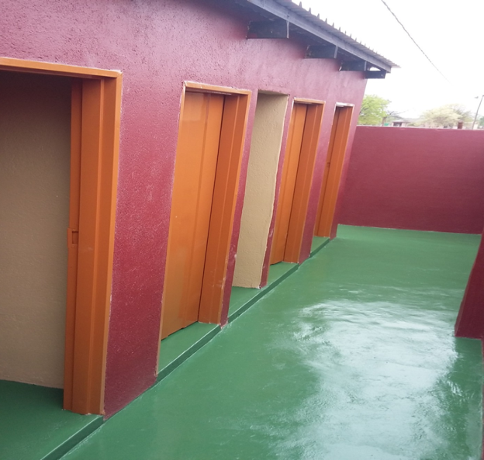
Guwela crèche improvement – Dzumeri area
AFTER
AFTER

Slide 18
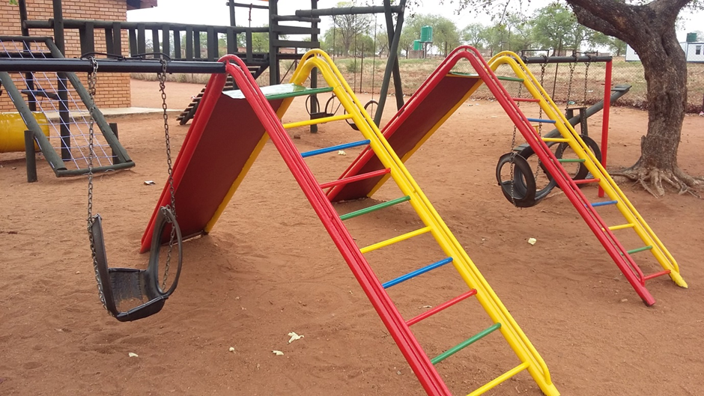
Guwela crèche improvement – Dzumeri area
AFTER

Slide 19
MIRMA DEVELOPMENT – VEGETABLE NURSERY
  For the past two year the staff at Mirma have established and maintained their own vegetable garden in an area next to the factory. This is a very successful endeavour as they manage to produce various veggies from this small section of land which they disperse among each other.
  As management we want to take this vegetable unit to a next level and keeping it in the values of Mirma of being structured and well managed also with a good aesthetic value to it.
  After the huge success Mirma development had with the food relief project we decided to construct four veggie tunnels and one shade netted covered area.
  The idea is to utilize these four areas to produce vegetables in throughout the year due to Phalaborwa being a frost free area and the veggies are protected in their tunnels. To add to the initiative every planting cycle we identify a crèche on a rotational base that will also be receiving produce from these “hot houses”. So each harvest will be shared by the staff and by a curtain crèche.
  The crèches Mirma will be assisting will be those that do not have their own veggie gardens due to a shortage or no water available in their area.

Slide 20
MIRMA DEVELOPMENT – VEGETABLE NURSERY
Bakeng sa lilemong tse peli tse fetileng basebeletsi ba Mirma ba thehile le ho boloka serapa sa bona sa meroho sebakeng se haufi le fektheri. Ena ke boiteko bo atlehileng haholo ha ba ntse ba khona ho hlahisa likokoana-hloko tse sa tšoaneng ho tloha karolong ena e nyenyane ea mobu eo ba e qhalakaneng har'a bona. Joaloka batsamaisi re batla ho nka semela sena sa meroho ho ea boemong bo latelang 'me re bo boloke ka litekanyetso tsa Mirma tsa ho hlophisoa le ho laoloa hantle le ka botle bo botle bo botle ho eona. Ka mor'a katleho e khōlō ea khōlo ea Mirma e ne e e-na le morero oa liphallelo tsa lijo re ile ra etsa qeto ea ho haha ​​lithapo tse 'nè tsa mekgote le moriti o le mong o koahetsoeng ke marulelo. Sepheo ke ho sebelisa libaka tsena tse 'nè ho hlahisa meroho ho pholletsa le selemo ka lebaka la Phalaborwa e le sebaka se se nang serame le mekotla e sirelelitsoeng litseleng tsa bona. Ho eketsa potoloho e 'ngoe le e' ngoe ea ho lema re khetholla mochine o motlakase o tla fumana lihlahisoa tse tsoang ho "matlo a chesang". Kahoo kotulo e 'ngoe le e' ngoe e tla arolelanoa ke basebeletsi le ka mokotlana oa lesira. Li-crèches Mirma li tla ba thusa ho ba ba se nang li-gardens tsa bona tsa veggie ka lebaka la khaello ea metsi kapa ha ho na metsi a teng sebakeng sa habo bona.

Slide 21
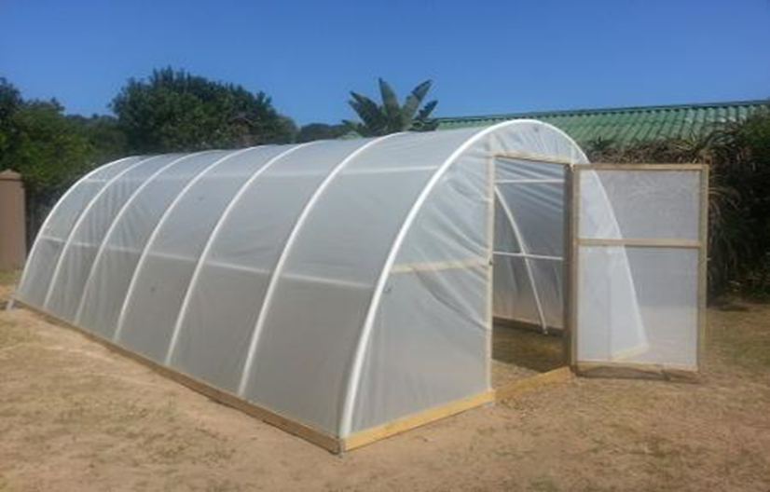
MIRMA DEVELOPMENT – VEGETABLE NURSERY

Slide 22
Marula trees donations
  SANParks and Londozolzi game reserve have started an initiative to rebuild the Lisbon farms for the rural community in the Hazyview area. They are plant 300ha of mango plant and 15ha of Marula trees on the property. These Marula trees will be grafted by ARC to ensure that they can deliver fruit and the local community in the future will be able to harvest fruit from this orchard. Mirma Development supported the cause by donating 1100 Marula trees to the cause.

Slide 23
Marula trees donations
SANParks le sebaka sa lipapali tsa Londozolzi li qalile mohato oa ho tsosolosa mapolasi a Lisbon bakeng sa sechaba sa mahaeng sebakeng sa Hazyview. Li na le limela tsa mango tse 300ha le lifate tse 15ha tsa Marula sebakeng seo. Lihlahla tsena tsa Marula li tla hlomathisoa ke ARC ho etsa bonnete ba hore li ka hlahisa litholoana 'me sechaba sa motse nakong e tlang se tla khona ho kotula litholoana ho serapa sena sa lifate tsa litholoana. Phetoho ea Mirma e tšehetsa sesosa sa ho fana ka lifate tse 1100 tsa Marula molemong.

Slide 24
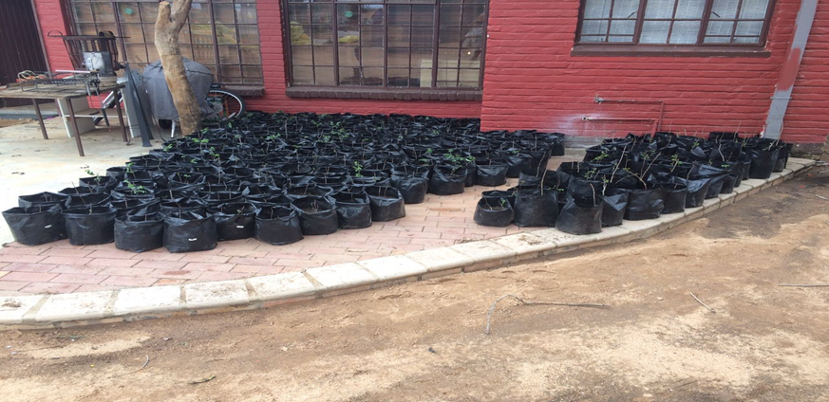
Marula trees donations

Slide 25
2017 Financial and community impact report
Financial
PROJECTS | Cost to company | Estimated cost
Food relief project | R 96 271.00
Base water crèche improvement – Makala region | R61 413.00
Kruger National park – soccer kit donations | R 49 061.00
Guwela crèche improvement – Mabunza area |  | R 150 000.00
Nursery development – food support initiative |  | R 45 283.85
Marula trees donations – Kruger National Park and Londozolzi Lisbon community farm | R 4 600.00
Total 2017 Mirma Development | R 406 628.00

Slide 26
2017 Financial and community impact report
Community Impact 2017
PROJECTS | Community impact | Cost per person | Classification
Food relief project | 10218 individuals | R 9.42 | Community up-liftment
Base water crèche improvement – Makala region | 105 individuals | R 584.88 | Community up-liftment
Kruger National park – soccer kit donations | 48 field rangers | R 1 022.10 | Environmental
Guwela crèche improvement – Mabunza area | 89 individuals | R 1 685.40 | Community up-liftment
Nursery development – food support initiative | 10 staff and 180 individuals per annum |  | Community up-liftment
Marula trees donations – Kruger National Park and Londozolzi Lisbon community farm | Lisbon community – 430 beneficiaries | R 10.70 | Environmental

Slide 27
2018 – Mirma development
Food relief project.
Vegetable donation from Mirma veggie tunnels to 4 crèche beneficiaries.
On the rotational roster – main line project in the Malebogo

Slide 28
2018 – Mirma development
Morero oa liphallelo.
Menehelo ea meroho e tsoang mekotleng ea Mirma veggie ho bahlabani ba 4 ba nang le melemo.
Lethathamong la ho potoloha - morero o ka sehloohong oa Malebogo

Slide 29
2018 – Mirma development
2010 |  | NXHUMALO |  |  | CLINIC
2011 |  | DZUMERI |  |  | CRECHE
2012 |  | NXHUMALO |  |  | BOREHOLE
2013 |  | MALEBOGO |  |  | BOREHOLE
2014 |  | MATLALA |  |  | FENCE PROJECT
2015 |  | MASEKE |  |  | CRECHE UP-GRADE
2016 |  | MAKUSHANE/Majeje |  |  | CRECHE UP-GRADE
2017 |  | DZUMERI |  |  | COMPLETED – CRECHE UP-GRADE
2018 |  | MALEBOGO
2019 |  | MATLALA
2020 |  | NXHUMALO
2021 |  | MASEKE
2022 |  | MAKUSHANE

Slide 30
Thank you
Kea leboha

