Slide 1
MARULA
AMARULA AND THE MARULA SNYERGY

Slide 2
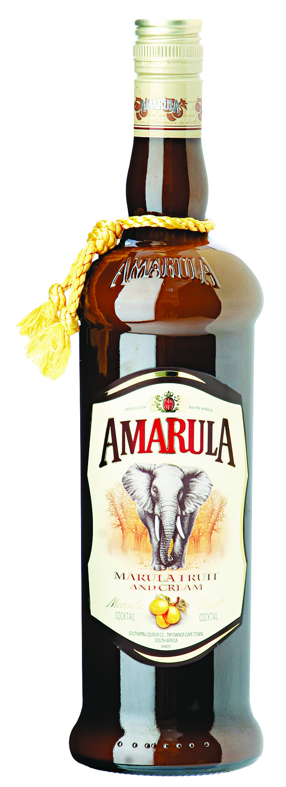
BACKGROUND – Amarula Brand
Currently 2 brands in the Amarula profile
    Amarula cream liquor
    Amarula gold liquor.
Amarula cream is available in more than 100 countries across the world and is one of South Africa's largest export brand.
Developed in 1983 as a clear sprit liquor and then in 1989 transformed to a cream liquor.
In 2013 Amarula gold was introduced to the market, a Marula liquor without a cream base.

Slide 3
Marula to Amarula journey
Harvest and De-Stoning
Fermentation and Distilling
Ageing process
Blending and Bottling

Slide 4
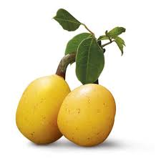
De-stoning plant– Mirma Products
Established in 1994 by Thys Slabbert in Phalaborwa as a Marula processing plant.
In 1998 JV with Distell for the supply of Marula fruit pulp to be used in the production of Amarula cream.
Current factory has 6 full time employees and 77 seasonal workers.
2015 - 3500 tons of fruit was processed.

Slide 5
Marula supply chain
Harvesters
Production facility
Transported to Stellenbosch

Slide 6
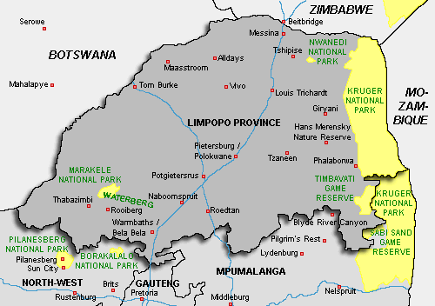
Harvesting process
Collect fruit from 16 villages in 3 regions
Southern region – Acornhoek (4 communities) – 10%
Central region – Ba-Phalaborwa ( 8 communities) – 85%
Northern region – Bochum (4 communities) – 5%

Slide 7
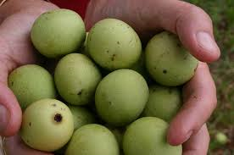
Harvesting and the rural community
No commercial farming.
Harvesters form small cooperatives.
Estimated 750 harvesters per season.
52 collection points with the rural communities.
Cash VS collection transaction.
Open market system no application requirement to supply fruit.
Area and purchase price negotiated on a formal structure that involves the traditional leaders of the three areas.
Commercial value of the harvest above R 2,000,000.00 per season.

Slide 8
Mirma Products - Social Impact
Mirma Delevopment has in the last 5 years:
  Built Edenburg clinic that attends to 1200 patients per month.
  Built Kheyi village crèche – 85 pupils.
  Sunk and equip 3 boreholes in the areas of Dumphries, Kheyi and Bochum.
  Built flush toilets and jungle gyms at Maseke, Majeje and Mashishimale day care centres
  Did 24 outreach days that included soup kitchens, sweets parcels and water bucket hand-outs to 24 different school and hospitals in the harvest regions.
  Research partners with various universities regarding product development around the Marula.

Slide 9
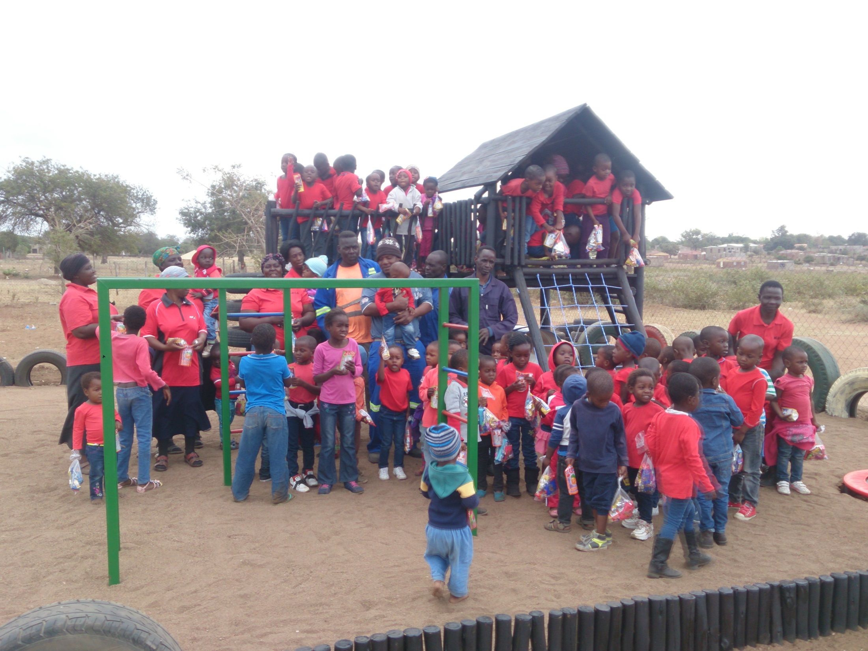

Slide 10
Sustainability of the Marula
Mirma products impact on the total Marula harvest.
  Currently 489 rural villages in Limpopo.
  65% of these villages have Marula tress in the geographical area of a 0-25km
  Total of 317 villages have access to Marula fruit in their living environment - Mirma product collects fruit from 16 of these villages (5%).
  High density area of Bochum 76 villages – Mirma collects from 4 of them and less than 1% of their possible harvest.
  Ba-Phalaborwa harvest to Mirma products less than 20% of the possible harvest in the area.

Slide 11
Limpopo and the Marula
Region is 123900 km₂
89% of Limpopo population live in non-urban areas.
54.6% of the population is female.
40% of Limpopo population is younger than 15 years.
Rural ladies use their natural surrounding to supplement their income e.g. Marula drinks, Mopani worms, clay brick making ext.
The necessity to develop other retail products like Amarula cream on large scale so that rural communities can benefit sustainably what nature provides them.

Slide 12
Possibilities within the Marula
Pulp:
    Fruit juice
    Vinegar
    Various retail products as Marula infused yogurts, relish ext.
Nuts
    Marula oil
    Nut cake
Kernels
    Charcoal production
Skins
    Archar production
There is currently enough fruit to sustain a number of commercial viable enterprises within the industry.

Slide 13
Mirma product – research development
We have started to monitor 5 trees in 5 different areas:
    Rainfall.
    Climate – weekly.
    Size of tree in trunk and canopy – every 6 months.
    Amount of fruit harvested per year – every year.
    Additional factors like fire, hail storms, ext. are documented.
The fruit from these trees are then documented for:
    Harvest time start to end.
    Kg quantity of the harvested.
    Average size of the fruit harvested
    Brix’s of the fruit harvested
All this data is then accumulated and using various methods we then determine what influence the weather and natural surroundings has on the fruit production of the Marula tree.

Slide 14
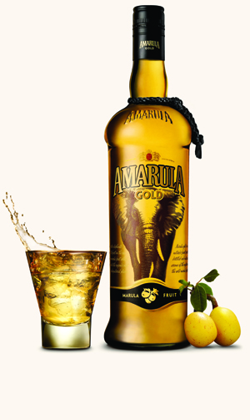
Thank you

